Slide 1
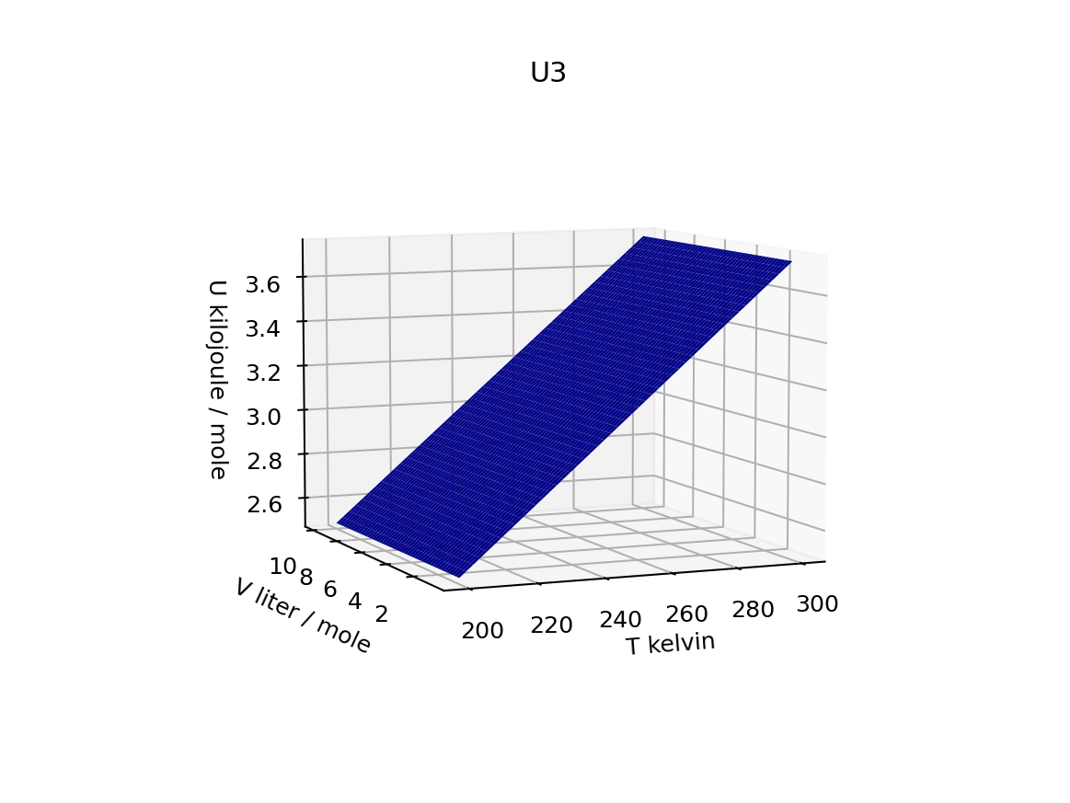
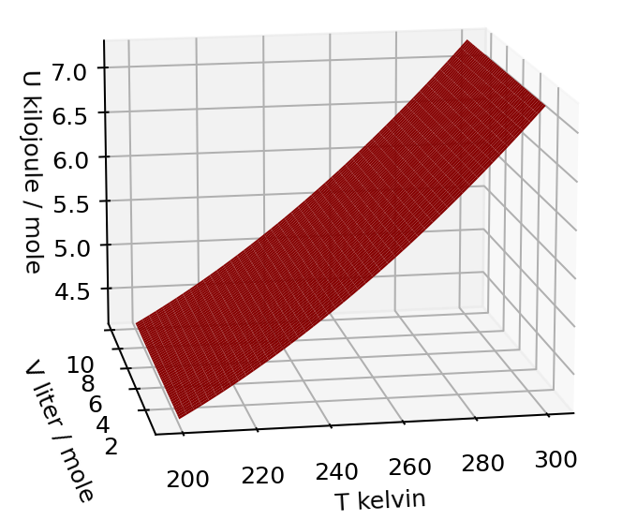
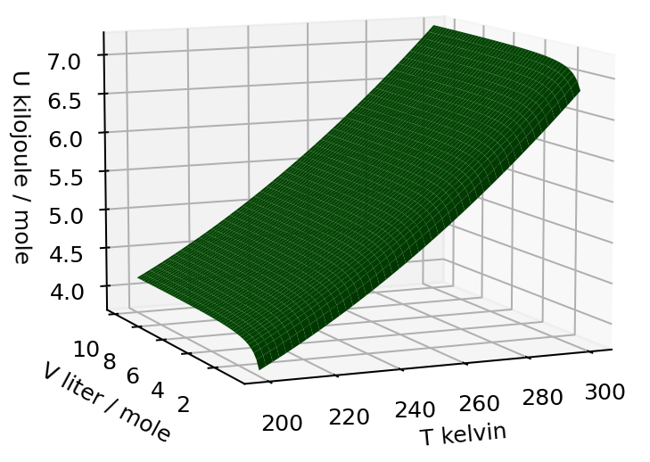
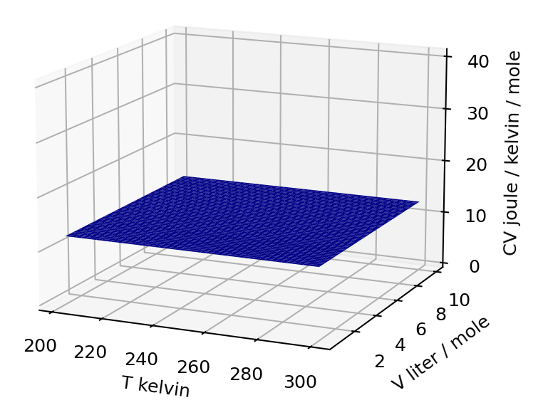
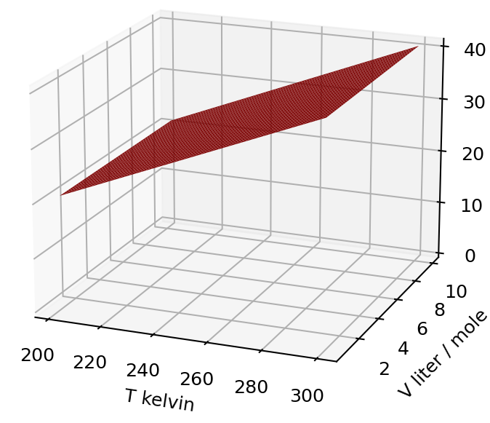
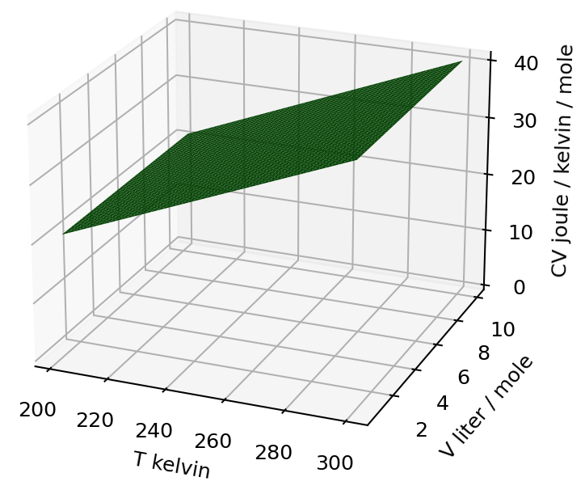
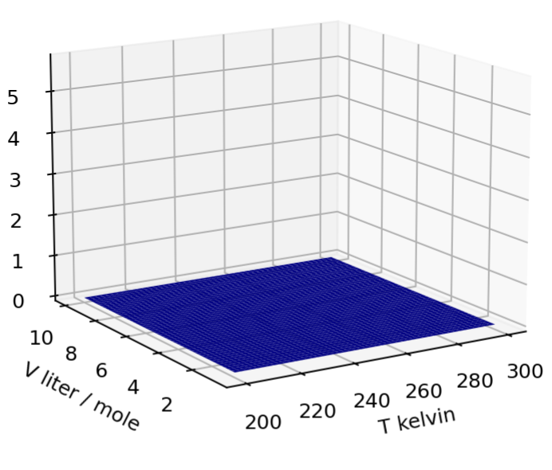
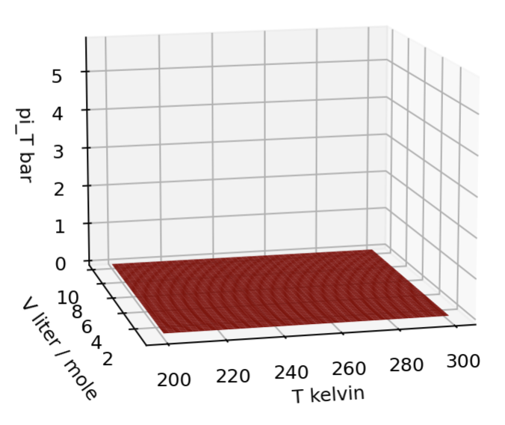
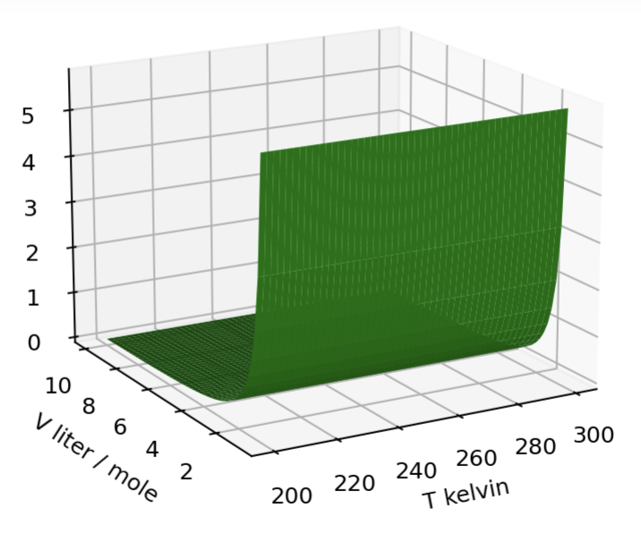



Visualizing $U(T,V)$, ${C_{V}≡\left(\frac{∂U}{∂T}\right)}_{V}$, and ${π_{T}≡\left(\frac{∂U}{∂V}\right)}_{T}$as thermodynamic surfaces
$$U(T,V)$$
$$C_{V}(T,V)$$
$$π_{T}(T,V)$$

